Slide 1

Are Airplanes Safe?
By: Mithil Patel

Slide 2

What is the issue here?
Due to a recent incident involving an airplane crash, rumors were circulating in the media surrounding the danger of traveling in airplanes.
The media analyst may have manipulated the data or incorrectly interpreted the result to fit their narrative toward airplanes.
The rumors have cast fear in people and have negatively impacted the aviation industry’s reputation.
As a valued employee of Delta airlines, I have to clear any doubts and shed light on the truth.

Slide 3
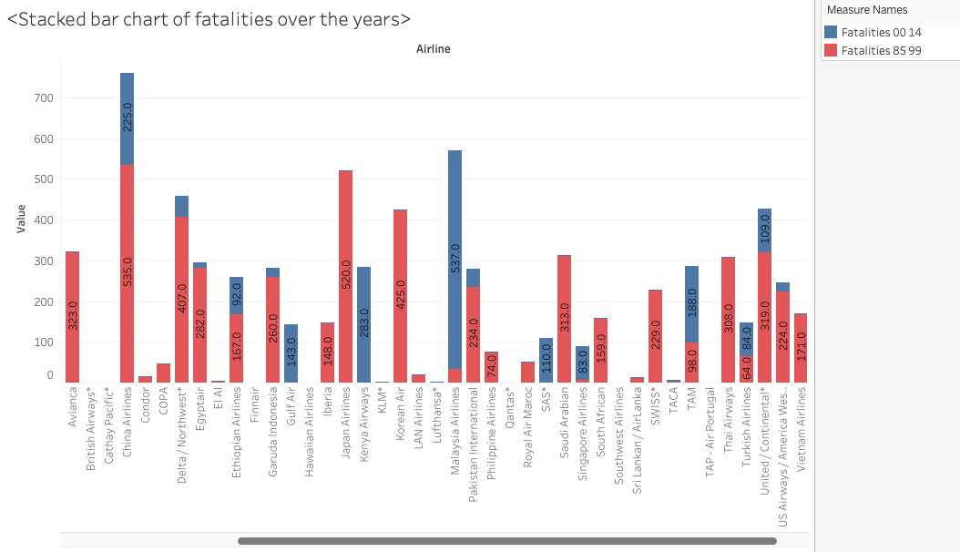
Is it Really True?
One assumption is that the number of incidents, or fatalities, will likely rise as more people opt to travel by air over the years.
However, a stacked bar chart of fatalities from two different time intervals (1984 to 1999 and 2000 to 2014) tells us a whole different story.
A direct comparison between the two different time periods shows that more fatalities occurred in the early years (red bars) than in recent years (blue bars).
Data source: Aviation Safety Network

Slide 4
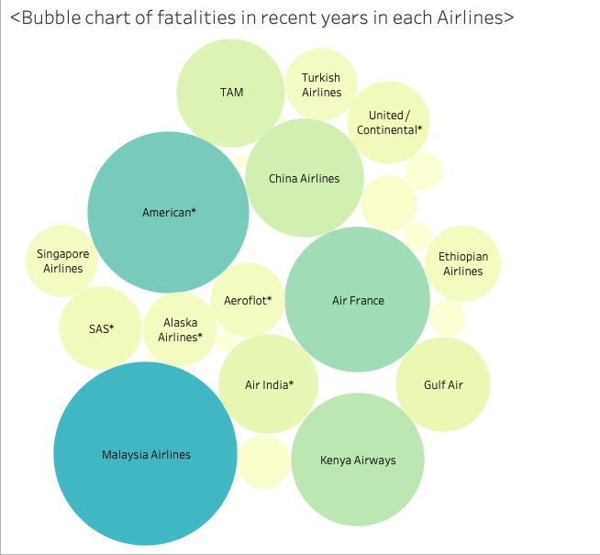
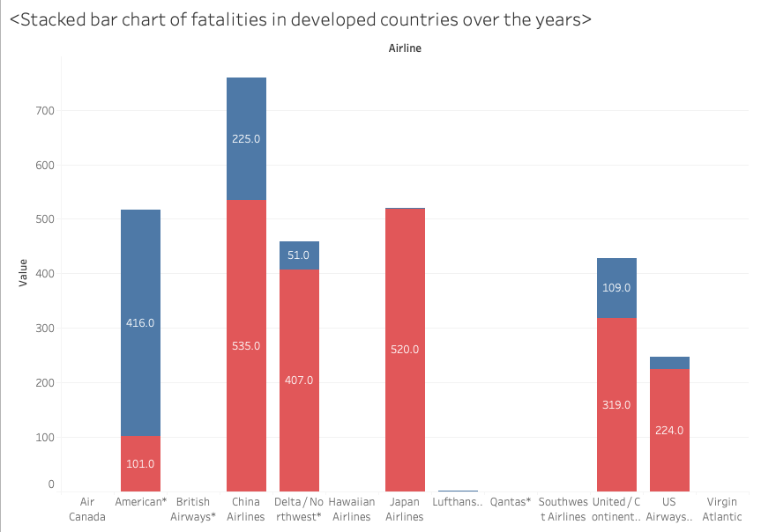
Then Where Do They Occur the Most?
A packed bubble chart of fatalities by each airline in recent years suggest that most of the incident occurs in airlines in developing countries (i.e., Malaysia Airways, Kenya Airways, etc.).
By excluding airlines from developing countries, the previously created stacked bar chart shows that the fatality rate dropped significantly in recent years compared to early years (shown in the bottom left graph).
For our airline (Delta), the number of fatalities decreased from 407 to 51, which is a massive improvement from the previous decade.
The high fatality rate during the early years can be attributed to primitive technology and the industry’s early phase, where rules and regulations were implemented with very limited knowledge. Similarly, airlines in developing countries are still in their early phase, hence the high fatality rate.

Slide 5
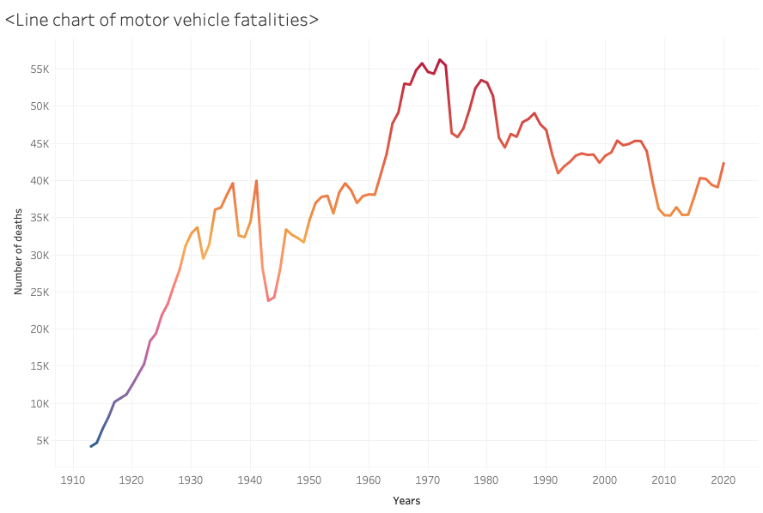
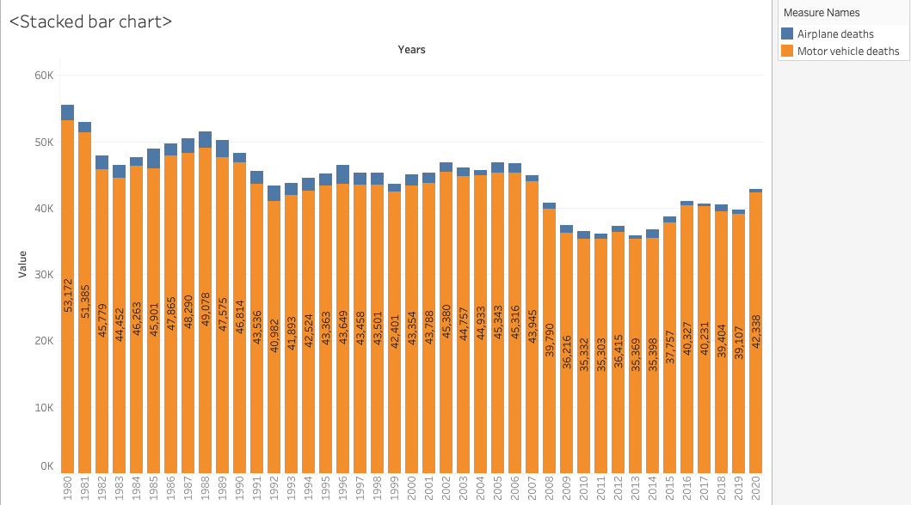
Let’s Look at Motor Vehicles
If airplanes are unsafe, we shall investigate how safe it is to travel in a motor vehicle.
A motor vehicle fatality line chart reveals that the motor vehicle fatality rate continues to rise and has reached its peak (56,000 deaths per year) within sixty years after being introduced to the public.
In recent years, the average fatality is nearly 45,000 car-related deaths per year, which is astronomy high compared to 56 deaths involving airplane crashes.
The stacked bar chart of motor vehicle and airplane fatalities patently highlights the danger of using motor vehicles as a means of transportation.

Slide 6
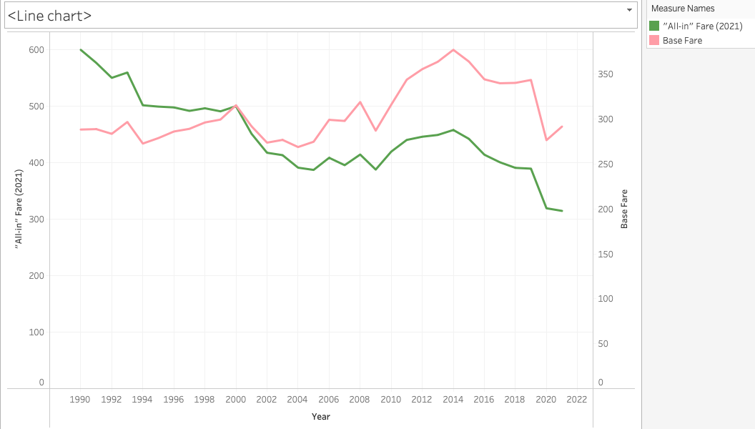
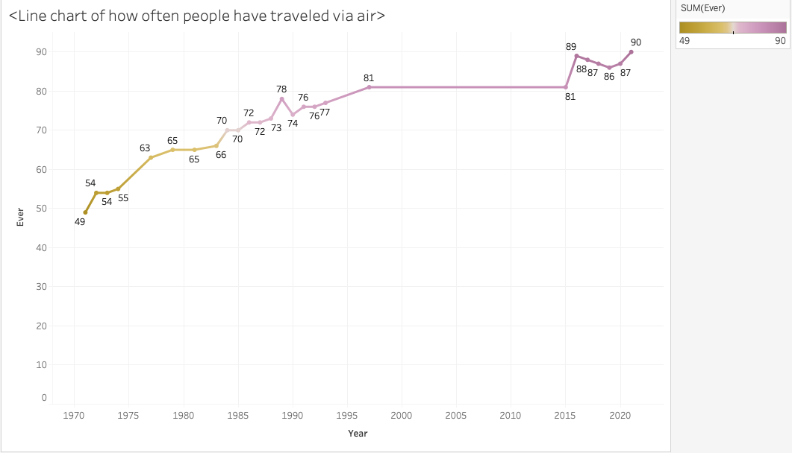
Benefit & Impact of Commercial Aviation
The line chart in the top right shows that in two decades, the base airfare increased by only 8% after adjusting for inflation; meanwhile, the “All-in” fare, which includes round-trip fare plus the baggage, has decreased by approximately 48%.
Since commercial airplanes have become safe and accessible, more travelers frequently use airplanes as a means of transportation, as shown in the bottom left chart.
The increasing in popularity has helped commercial aviation industry to account for 5percent of U.S. GDP, which is the equivalent of $1.25 trillion in 2022. Additionally, the industry provides nearly 8.7 million jobs.
The other benefits includes promote of tourism, living standards improvement, poverty, and business growth.

Slide 7

Conclusion
As a result of recent airplane crash, the news & media outlet questioned the safety of the airplane by promoting statistics and stating the danger of traveling via air.
However, the number of fatalities by Delta Airlines and other airlines in developed nations has significantly decreased as the industry has adopted advanced technologies and implemented rules and regulations to enhance guests' safety.
By comparison, traveling by motor vehicle is far more dangerous than airplanes and has accounted for, on average, approximately 45,000 fatalities per year.
The commercial aviation industry significantly contributes to social and economical benefits. Several benefits includes promotes economical growth, tourism, poverty, etc.

Slide 8
Reference
Impact | Airlines for America. https://www.airlines.org/impact/
Social and Economic Benefits of Aviation, https://www.atag.org/our-activities/social-and-economic-benefits-of-aviation.html

